Slide 1

Project Review
on
WellBin
[Smart City Solutions for Clean Living and Health Monitoring]
by Shashwat Singh (RA2011004010374) Srinath Chepuri (RA2011004010386)
Sankalp Sharma (RA2011004010406)
[Batch No. SP46]
Under the guidance of
Dr. Vivek Devendra Kachhatiya
Assistant Professor, Department of ECE

Slide 2
Abstract
In the ever-evolving landscape of urbanization, the concept of a "Smart City" has emerged as a visionary solution to address the multifaceted challenges of modern urban life. Leveraging the power of the Internet of Things (IoT), we embark on a transformative journey to design and implement cutting-edge applications that will not only enhance the quality of life for city residents but also pave the way for more sustainable, efficient, and interconnected urban environments. In our major project, “WELLBIN – Smart City Solutions for clean living and health monitoring," we are focusing on two key innovations. The first, "IoT-based Health Monitoring System," leverages IoT devices for real-time health data, enhancing healthcare and health management. The second, "IoT-based Smart Garbage Alert System," uses sensors and data analysis to optimize waste collection and improve city cleanliness. Through these applications, we aim to transform urban living by harnessing IoT technology for smarter, healthier, and more sustainable cities.

Slide 3
Objectives
The overarching objectives of the WELLBIN project can be delineated into two distinct yet interconnected sub-projects:
1. IoT-based Health Monitoring System:
Develop a comprehensive health monitoring system leveraging IoT technologies to collect real-time data on vital health parameters.
Create user-friendly interfaces for individuals to access and interpret their health data, promoting proactive health management.
2. IoT-based Smart Garbage Alert System:
Design and deploy a network of IoT-enabled sensors within urban waste management systems to monitor garbage levels in real-time.
Enhance public awareness and participation through user-friendly interfaces, encouraging citizens to actively contribute to cleaner and more sustainable urban environments.
3. Integration of both Systems

Slide 4
Literature Review
[1] S. Misra, S. Pal, N. Pathak, "i-AVR: IoT-Based Ambulatory Vitals Monitoring and Recommender System," IEEE Internet of Things Journal, vol. 10, no. 12, pp. 1-1, Jun. 15, 2023.
Abstract : i-AVR, an IoT-based system addressing ambulance delays. It combines a healthcare unit to compute patient criticality and recommend the nearest healthcare center with an Android navigation unit for route guidance, demonstrating quick decision-making capabilities in critical medical situations
[2] Sosunova, I., & Porras, J. (2022). IoT-enabled smart waste management systems for smart cities: A systematic review. IEEE Access, 10, 73326-73363.
Abstract : This paper conducts a systematic literature review on smart waste management (SWM) systems, analyzing 173 primary studies out of 3,732 retrieved from 5 databases. It identifies key approaches, sensors, stakeholders, data sharing, and research gaps in SWM, providing recommendations for city and smart garbage bin-level SWM system implementation.

Slide 5
Literature Review
[3] Abdalzaher, M. S., Fouda, M. M., Elsayed, H. A., & Salim, M. M. (2023). Toward secured IoT-based smart systems using machine learning. IEEE Access, 11, 20827-20841.
Abstract :
This paper discusses the integration of Machine Learning (ML) and the Internet of Things (IoT) in the development of "Smart x" systems, including smart cities, campuses, and early warning systems. It highlights the importance of IoT in smart systems, provides a taxonomy of ML models, addresses security aspects in IoT networks, and presents case studies in smart campus and earthquake early warning systems.
[4] Rajab, H., & Cinkelj, T. (2018). IoT based smart cities. In 2018 International Symposium on Networks, Computers and Communications (ISNCC) (pp. 1-6). IEEE.
Abstract :
The rise of IoT in enabling Smart City projects worldwide, highlighting both the benefits and risks. It mentions the rapid growth of connected objects and their impact on urban development. The article also delves into IoT's vulnerabilities and potential solutions for smart city applications.

Slide 6
Literature Review
[5] Siam, A. I., El-Affendi, M. A., Abou Elazm, A., El-Banby, G. M., & El-Bahnasawy, N. A. (2023). Portable and real-time IoT-based healthcare monitoring system for daily medical applications. In 2023 IEEE 11th International Conference on Cloud Computing (CLOUD) (pp. 1-8). IEEE.
Abstract : A portable health monitoring system leveraging IoT technology. It tracks vital health parameters, offers local or cloud-based data transmission, and demonstrates high accuracy, making it suitable for daily medical applications and remote patient care.
[6] E. Likotiko, Y. Matsuda, K. Yasumoto, "Garbage Content Estimation Using Internet of Things and Machine Learning," IEEE Access, vol. 11, pp. 1-1, Feb. 3, 2023.
Abstract : This study addresses the need for effective household garbage management by introducing a new smart garbage bin system (SGBS) equipped with multiple sensors.

Slide 7
Literature Review
[7] N. Taimoor and S. Rehman, "Reliable and Resilient AI and IoT-Based Personalised Healthcare Services: A Survey," IEEE Access, vol. 10, pp. 535-563, Dec. 22, 2021.
Abstract : This paper conducts a comprehensive survey on personalized healthcare services. In particular, we first present an overview of key requirements of comprehensive personalized healthcare services (CPHS) in modern healthcare Internet of Things (HIoT), including the definition of personalization and an example use case scenario as a representative for modern HIoT.
[8] W. A. N. A. Al-Nbhany, A. T. Zahary, A. A. Al-Shargabi, "Blockchain-IoT Healthcare Applications and Trends: A Review," IEEE Access, vol. 12, pp. 4178-4212, Jan. 2, 2024.
Abstract :Healthcare IoT applications are one of the industries that will be revolutionized by using IoT-blockchain technology. This review aims to provide an integrated understanding of blockchain IoT healthcare applications. The methodology of our paper is to review the literature from 2018 to 2023, paying more attention to research that intersects and integrates IoT, Blockchain, and healthcare applications.

Slide 8
Literature Review
[9] A. Subrahmannian and S. K. Behera, "Chipless RFID Sensors for IoT-Based Healthcare Applications: A Review of State of the Art," IEEE Transactions on Instrumentation and Measurement, vol. 71, article sequence number 8003920, Jun. 6, 2022.
Abstract : Chipless RFID sensors with the Internet of Things (IoT) technology have the full potential to meet the requirements of the growing demand. With the development of present technologies, the IoT-based solutions are no longer a challenging vision that offers various potential benefits to today’s world, especially healthcare which is an encouraging field of IoT.
[10] C. Nwibor, S. Haxha, M. M. Ali, M. Sakel, A. R. Haxha, K. Saunders, "Remote Health Monitoring System for the Estimation of Blood Pressure, Heart Rate, and Blood Oxygen Saturation Level," IEEE Sensors Journal, vol. 23, no. 5, pp. 5401-5411, Mar. 1, 2023.
Abstract :This article presents the design and implementation of an Internet of Things (IoT)-based remote health monitoring system for the estimation of blood pressure (BP), heart rate (HR), and blood oxygen saturation levels (SpO2). Our designed sensor can remotely monitor BP, HR, and SpO2.

Slide 9
Problem Statement
The problem at hand is the absence of an integrated, data-driven solution for efficient waste management and proactive public health monitoring in urban environments, which the WellBin and SmartCity Insights Platform aims to address through the utilization of sensor data.

Slide 10
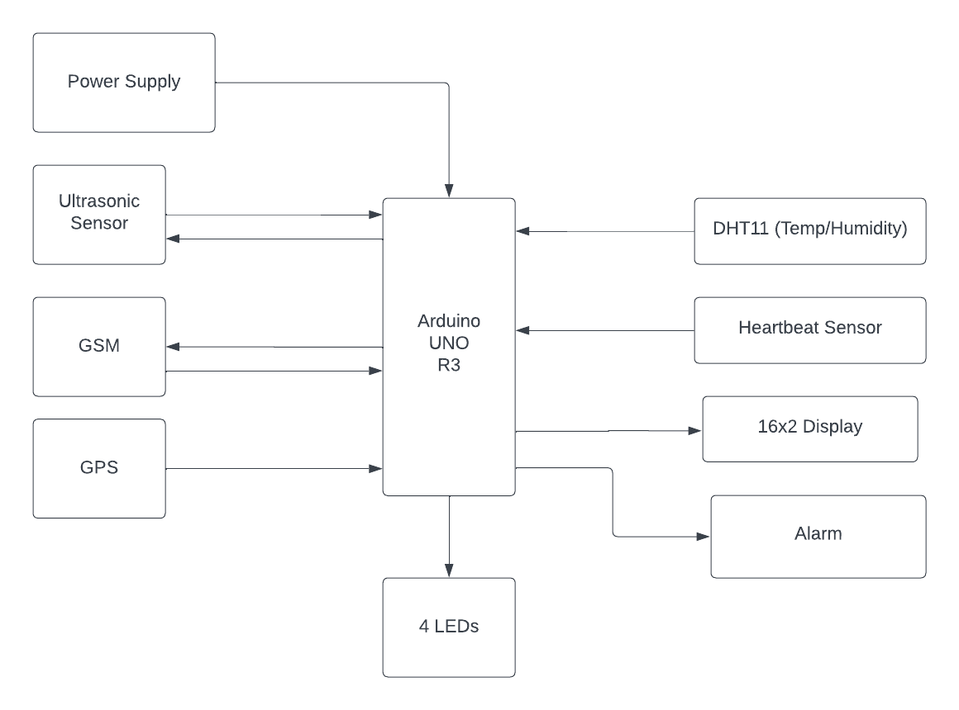
Block Diagram

Slide 11
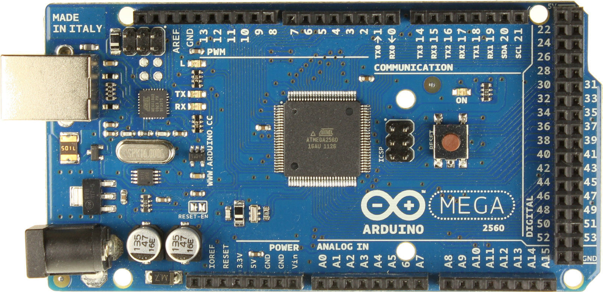
Arduino Mega 2560
The Arduino Mega 2560 is a microcontroller board based on the ATmega2560 chip. It is part of the Arduino family and is an enhanced version compared to the Arduino Uno.
The Arduino Mega 2560 is considered better than the Arduino Uno for several reasons:
Increased Resources:
The Mega 2560 has significantly more Flash memory (256 KB compared to Uno's 32 KB) and RAM (8 KB compared to Uno's 2 KB). This allows for more complex and larger programs.
Expanded I/O Capability:
The Mega 2560 provides a substantial increase in the number of digital I/O pins (54 compared to Uno's 14) and analog input pins (16 compared to Uno's 6). This makes it suitable for projects that require a larger number of sensors, actuators, or other peripherals.
Multiple UART Ports:
The Mega 2560 features four hardware UART ports, enabling multiple serial communication interfaces concurrently. This can be advantageous for applications requiring communication with multiple devices.

Slide 12
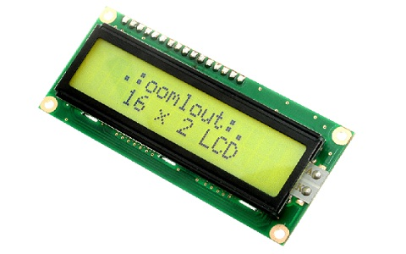
LCD Display and Sensors
LCD Display :
Liquid crystal display a type of display used in digital watches and many portable computers. LCD displays utilize two sheets of polarizing material with a liquid crystal solution between them. An electric current passed through the liquid causes the crystals to align so that light cannot pass through them. Each crystal, therefore, is like a shutter, either allowing light to pass through or blocking the light.

Slide 13
Sensors
1. DHT11 : DHT11 Temperature & Humidity Sensor features a temperature & humidity sensor
complex with a calibrated digital signal output. By using the exclusive digital-signal-acquisition
technique and temperature & humidity sensing technology, it ensures high reliability and
excellent long-term stability. This sensor includes a resistive-type humidity measurement
component and an NTC temperature measurement component, and connects to a highperformance 8-bit microcontroller, offering excellent quality, fast response, anti-interference
ability and cost-effectiveness.
2. Pulse Sensor :
A pulse sensor is a device designed to measure the heartbeat rate by detecting the pulsatile flow of blood through an artery. It is a valuable tool in various applications, particularly in healthcare, fitness monitoring, and physiological research. The pulse sensor captures the pulsatile signal produced by the rhythmic contraction and relaxation of the heart's chambers, known as the pulse wave.
3. HC-SR04(Ultrasonic Sensor) : An ultrasonic sensor is a device that utilizes ultrasonic sound waves for distance measurement, object detection, and various applications. These sensors work on the principle of echolocation, similar to how bats navigate by emitting sound waves and detecting their reflections

Slide 14
GPS and GSM modules
A GSM (Global System for Mobile Communications) module is a hardware component that enables communication between electronic devices and the GSM network. It provides a means for devices to send and receive data, including text messages, calls, and internet connectivity.
Components:
Microcontroller/Processor: The module is equipped with a microcontroller or processor responsible for handling communication protocols and managing data transfer.
SIM Card Slot: A slot for inserting a Subscriber Identity Module (SIM) card, which authenticates the device on the mobile network and provides access to the subscriber's account.
Antenna: An antenna is used for transmitting and receiving signals to and from the GSM network.

Slide 15
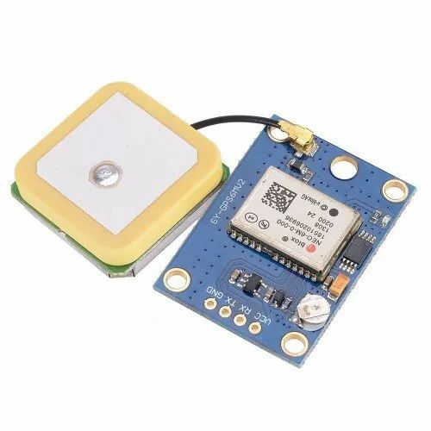
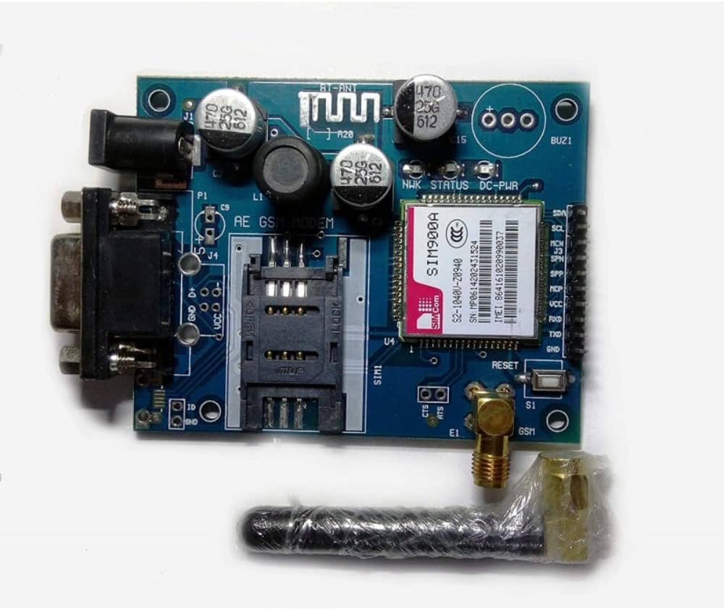
GPS and GSM modules
Global Positioning System (GPS) is a satellite-based navigation system that provides accurate location and time information anywhere on or near the Earth's surface. It is a critical technology used in various applications, ranging from navigation and mapping to agriculture, transportation, emergency services, and beyond.
To incorporate GPS (Global Positioning System) in a project, especially one involving IoT-based applications, offers the advantage of real-time location tracking and data correlation.
GPS Module : GSM module :

Slide 16
Compilation and Integration
Arduino sketches (programs) are typically written in a subset of C++ known as the Arduino programming language. This language simplifies some aspects to make it more accessible for beginners while still allowing for powerful and flexible programming.
Arduino Integrated Development Environment (IDE):
The Arduino IDE is the software used to write, compile, and upload code to Arduino boards. It provides a user-friendly interface, a code editor, and tools to compile and upload code to the Arduino hardware.
Compilation Process:
When you write an Arduino sketch, the code is compiled into machine code that the Arduino microcontroller can understand. The compilation process involves translating the human-readable code into a binary format that the hardware can execute.
Compilation Errors and Debugging:
The Arduino IDE helps identify and highlight compilation errors, making it easier for users to debug their code. The IDE also provides a serial monitor for debugging and viewing output from the Arduino board.

Slide 17
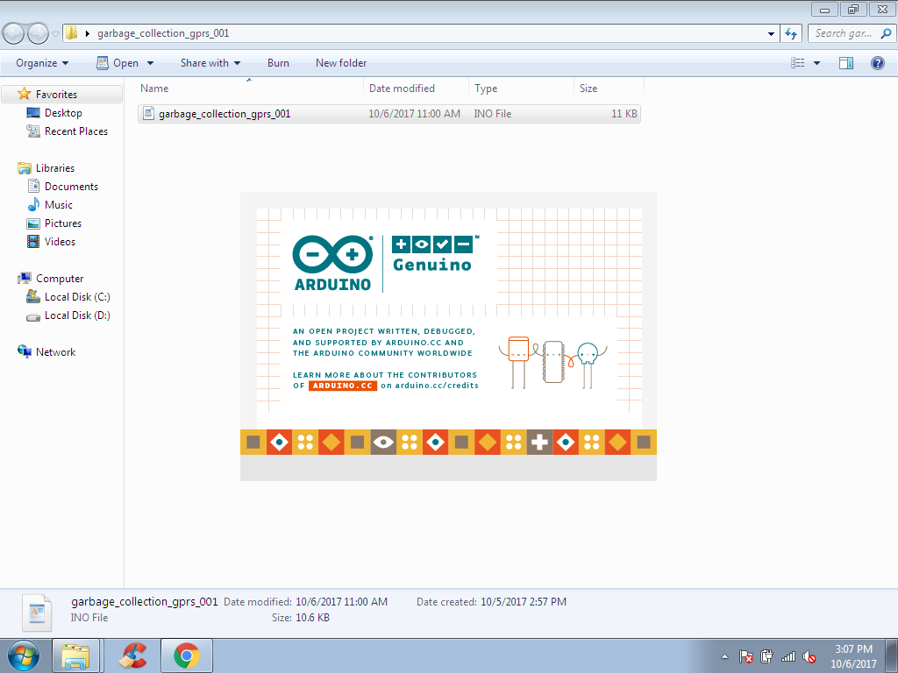
Compilation and Integration

Slide 18
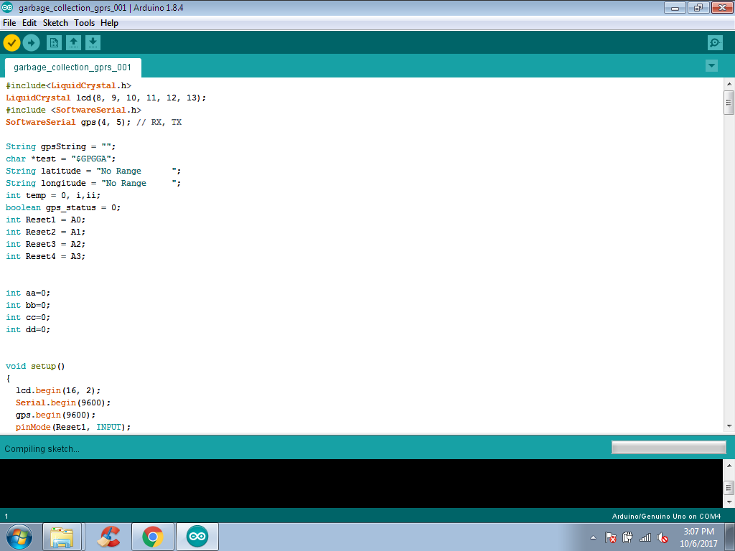
Compilation and Integration(contd.)

Slide 19
SmartCity Insights Platform (Website Integration)
User Authentication:
Secure user authentication ensures that only authorized individuals can access sensitive health and environmental data.
Dashboard Overview:
Upon logging in, users are presented with an intuitive dashboard providing an overview of the latest health metrics and garbage status.
Health Monitoring Section:
3.1 Real-time Vital Signs:
Visual representation of real-time health data including temperature and heart rate.
3.2 Historical Data:
Access to historical health data for trend analysis and monitoring changes over time.
Smart Garbage Monitoring Section:
4.1 Bin Status:
Live status updates on garbage bin fill levels.
4.2 Geographical Tracking:
Visual representation of bin locations on a map for efficient waste management.

Slide 20
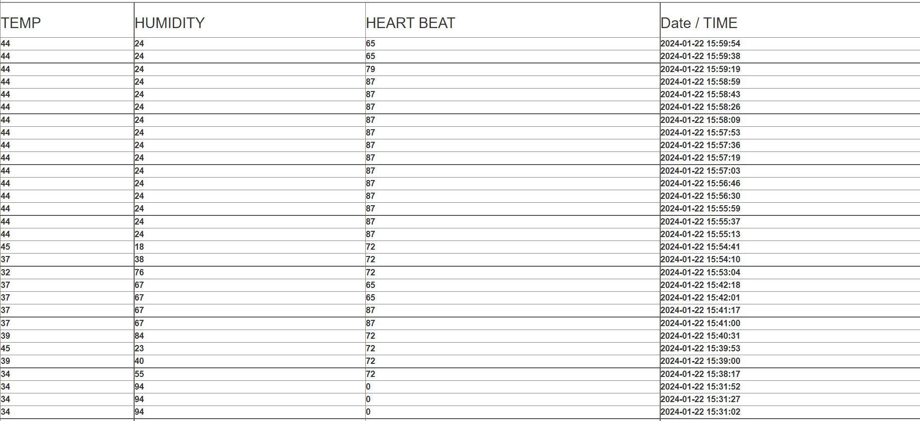
Sensors Data
The SmartCity Insights Platform is an integrated solution that harnesses sensor data from health monitoring and smart garbage systems to provide comprehensive analytics for informed decision-making in a smart city environment. This platform converges health and environmental data, fostering a holistic approach to urban well-being.

Slide 21
Results
Modularity and Upgradability:
Forecast: The project design will prioritize modularity, allowing for easy replacement or upgrading of components, ensuring adaptability to future technological advancements.
Compliance with Standards:
Forecast: Adherence to engineering standards, regulatory requirements, and safety norms will contribute to the project's credibility, reliability, and acceptance within the relevant industries.
User Acceptance:
Forecast: A user-friendly interface, coupled with reliable performance, is anticipated to lead to high user acceptance and satisfaction, promoting the widespread adoption of the health monitoring and smart garbage systems.
Positive Impact on Urban Living:
Forecast: The successful implementation of both systems is expected to
contribute positively to the overall quality of urban living, promoting health
and environmental well-being.

Slide 22
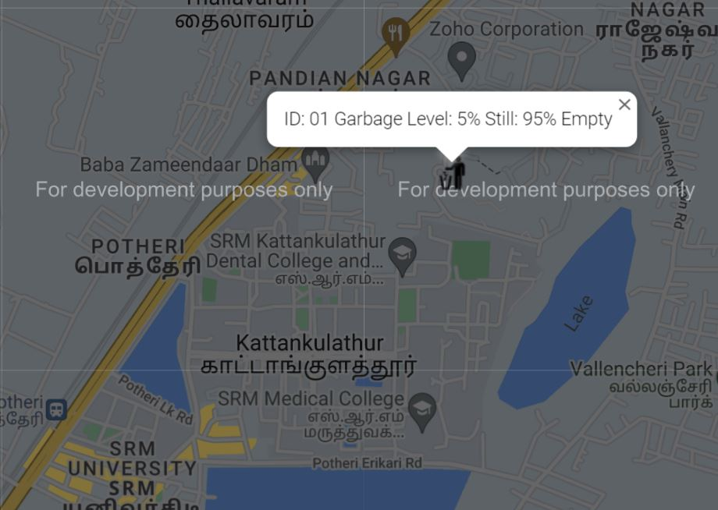
Results
The data collected from the sensors can be organized and accessed through the SmartCity Insights Platform.

Slide 23
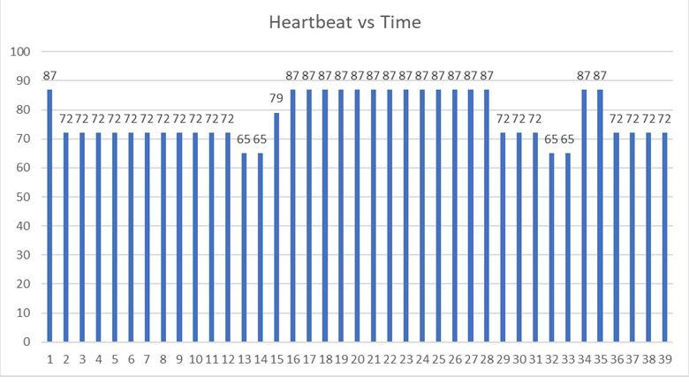
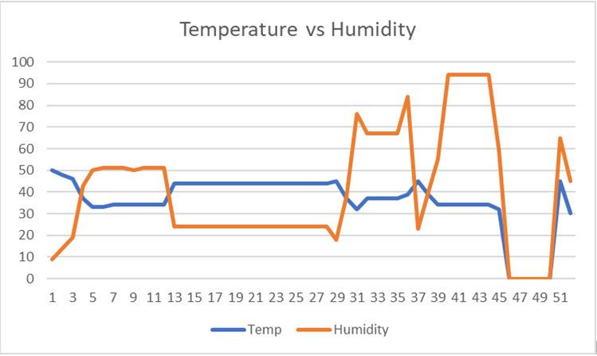
Results
Data collected from the sensors can be studied in real time and graphs can be plotted against it. Examples are given below :

Slide 24
References
[1] S. Misra, S. Pal, N. Pathak, "i-AVR: IoT-Based Ambulatory Vitals Monitoring and Recommender System," IEEE Internet of Things Journal, vol. 10, no. 12, pp. 1-1, Jun. 15, 2023.
[2] Sosunova, I., & Porras, J. (2022). IoT-enabled smart waste management systems for smart cities: A systematic review. IEEE Access, 10, 73326-73363.
[3] Abdalzaher, M. S., Fouda, M. M., Elsayed, H. A., & Salim, M. M. (2023). Toward secured IoT-based smart systems using machine learning. IEEE Access, 11, 20827-20841.
[4] Rajab, H., & Cinkelj, T. (2018). IoT based smart cities. In 2018 International Symposium on Networks, Computers and Communications (ISNCC) (pp. 1-6). IEEE.
[5] Siam, A. I., El-Affendi, M. A., Abou Elazm, A., El-Banby, G. M., & El-Bahnasawy, N. A. (2023). Portable and real-time IoT-based healthcare monitoring system for daily medical applications. In 2023 IEEE 11th International Conference on Cloud Computing (CLOUD) (pp. 1-8). IEEE.
[6] E. Likotiko, Y. Matsuda, K. Yasumoto, "Garbage Content Estimation Using Internet of Things and Machine Learning," IEEE Access, vol. 11, pp. 1-1, Feb. 3, 2023.
[7] N. Taimoor and S. Rehman, "Reliable and Resilient AI and IoT-Based Personalised Healthcare Services: A Survey," IEEE Access, vol. 10, pp. 535-563, Dec. 22, 2021.
[8] W. A. N. A. Al-Nbhany, A. T. Zahary, A. A. Al-Shargabi, "Blockchain-IoT Healthcare Applications and Trends: A Review," IEEE Access, vol. 12, pp. 4178-4212, Jan. 2, 2024.
9] A. Subrahmannian and S. K. Behera, "Chipless RFID Sensors for IoT-Based Healthcare Applications: A Review of State of the Art," IEEE Transactions on Instrumentation and Measurement, vol. 71, article sequence number 8003920, Jun. 6, 2022.
[10] C. Nwibor, S. Haxha, M. M. Ali, M. Sakel, A. R. Haxha, K. Saunders, "Remote Health Monitoring System for the Estimation of Blood Pressure, Heart Rate, and Blood Oxygen Saturation Level," IEEE Sensors Journal, vol. 23, no. 5, pp. 5401-5411, Mar. 1, 2023.

Slide 25
Acknowledgement
THANK YOU
Presenters –
Shashwat Singh (RA2011004010374)
Srinath Chepuri(RA2011004010386)
Sankalp Sharma(RA2011004010406)

